Slide 1
0x407 – Introducing Ghidra
ECED4406 – Computer Security
Dr. Colin O’Flynn
Dalhousie University.

Slide 2
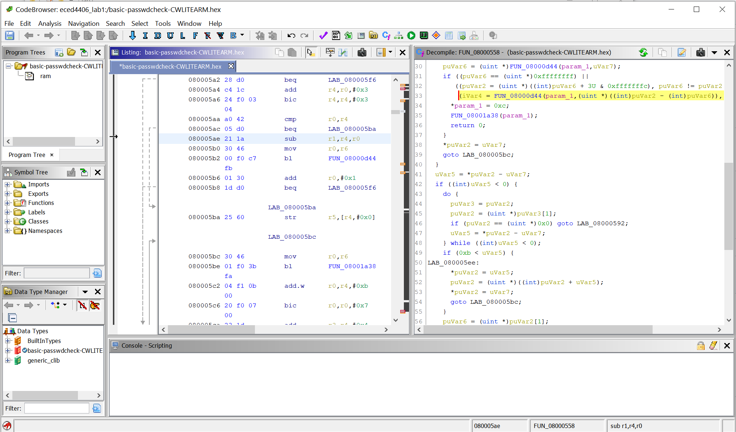
What does Ghidra Do?

Slide 3
Installing Ghidra
Ghidra runs on Mac/Windows/Linux.
The official site is at https://ghidra-sre.org/
If you are installing on Windows – recommend instead use my version from https://github.com/colinoflynn/eced4406/releases/download/0.0/ghidra_9.1.2_PUBLIC_WITHJRE.zip
This should “just work” on Windows.
See Lab #1 instructions for more about getting Ghidra installed.

Slide 4
Ghidra – Reverse Engineering Tool
Allows inspection of executables – that is binaries which contain runnable code.
Many tools for analysis of the programs.

Slide 5
Ghidra Resources
Overview course: https://ghidra.re/courses/GhidraClass/Beginner/Introduction_to_Ghidra_Student_Guide_withNotes.html#Introduction_to_Ghidra_Student_Guide.html
Hackaday full course (x86 based):
https://hackaday.io/course/172292-introduction-to-reverse-engineering-with-ghidra

Slide 6
Ghidra 101
We need to tell Ghidra the “language” it expects.
This is basically the processor type – such as Arm Cortex-M
Ghidra also needs to know little or big endian code format (if the processor supports both).
Most Arm Cortex-M devices are little endian.
Ghidra needs to know the starting address if you are loading a raw binary.
We will start with Intel Hex in lab 1 to simplify things slightly.

Slide 7
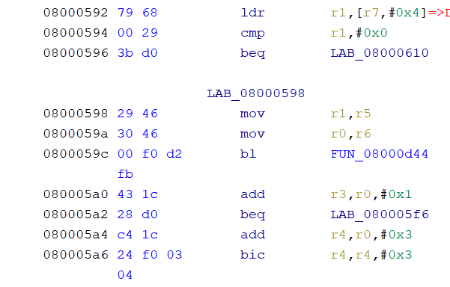
Ghidra 101 – Cont’d
Ghidra performs an auto analysis, which hopefully identifies instructions.

Slide 8
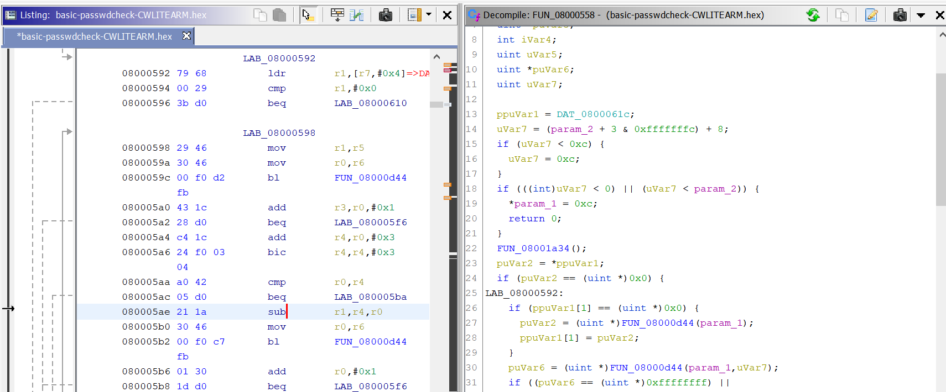
Decompiler
Ghidra can “decompile” from assembly to C code.

Slide 9
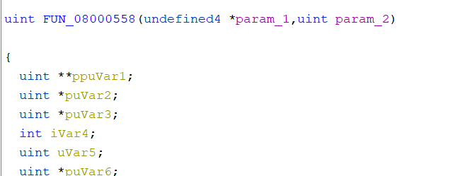
About the Decompiled Code
The decompiler does not make nice C code – we have no idea on what variables are.
The decompiler will expose optimizations that make code more confusing.
The decompiler has no idea about what function arguments there are:

Slide 10
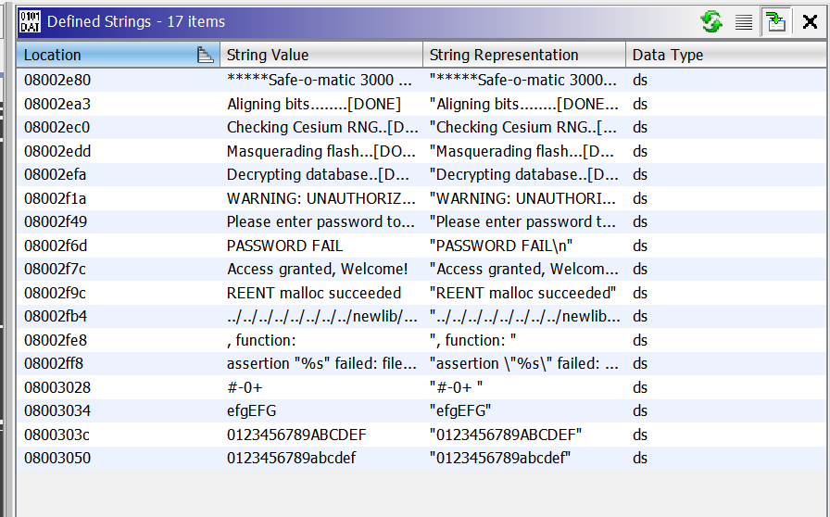
Useful Views: Strings
Window → Defined Strings

Slide 11
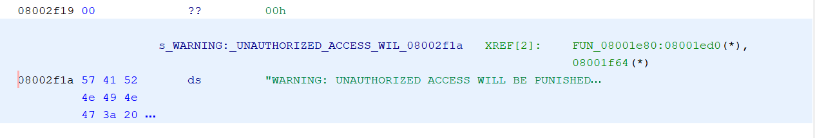
Ghidra – Cross Reference (“XREF”)
One of most powerful tools – see where code/data is referred to by.
This function is referring to that string! Interesting…
Double-click on it to jump to the function.

Slide 12
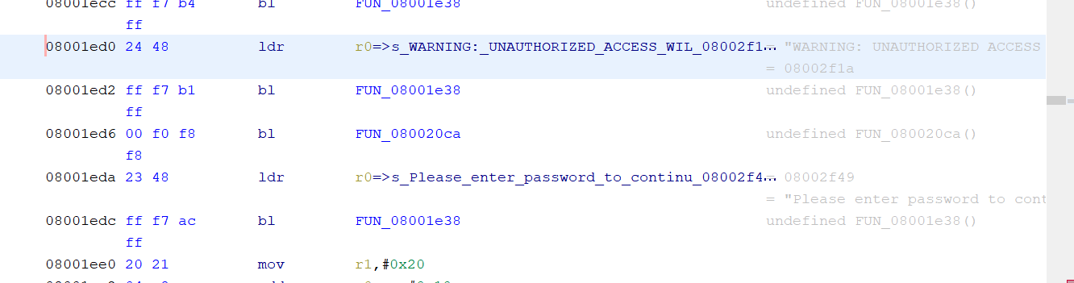
Example – Figuring out puts
This “FUN_08001e38” seems to be called repeatedly, and with a string argument?

Slide 13
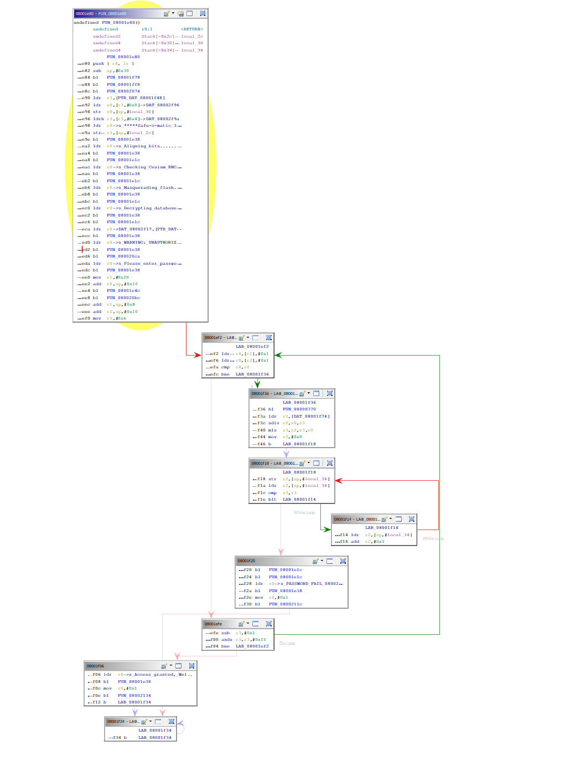
Useful Views: Function Graph
Window → Function Graph

Slide 14
Ghidra Getting Started
Easiest way is to explore with it a little bit!
See Lab #1 “Setup” instructions to be able to load this file.
Lab #1 will have you work with it in a little more detail.

